Slide 1
Code9 Web app workshop
JavaScript and Angular
Teodor Vasić, Aleksandar Mišljenović Microsoft-1 TnT
Novi Sad, 27-05-2021

Slide 2
Agenda Slide
01
05
About Lecturers
Questions and end slides
02
JavaScript Basics
03
TypeScript Basics
04
Angular Basics

Slide 3
01. About Lecturers
Aleksandar Mišljenović
Bachelor’s degree in computer science and engineering, Faculty of Technical Sciences, University of Novi Sad
.Net developer Medior
Working at Levi 9 office in Novi Sad
Teodor Vasić
Bachelor’s degree in computer science and engineering, currently at Master Studies, Faculty of Technical Sciences, University of Novi Sad
.Net developer Junior
Working at Levi 9 office in Novi Sad

Slide 4
02. Java script basics
JavaScript intro
About JavaScript
For what we use JS
How we use Js
JavaScript syntax
Difference between var, let and const
Operators in JS
Conditional and Loops in JavaScript
If, Else, Switch
While, Do
Break, Continue
Objects and Functions
Objects
Functions
Arrow Functions
Promises

Slide 5
Java script intro
Is a high-level, just-in-time compiled, multi-paradigm programming language that conforms to the ECMAScript specification.
JS is crated by Brendan Eich for Netscapes web browser Navigator in September 1995.
First name of JavaScript was LiveScript
Alongside HTML and CSS, JavaScript is one of the core technologies of the World Wide Web.
JS main purpose was to make HTML pages more dynamic
Today we use JS for many more things (JavaScript Everywhere Paradigm), but main purpose still remains same (making plain boring HTML pages dynamical)

Slide 6
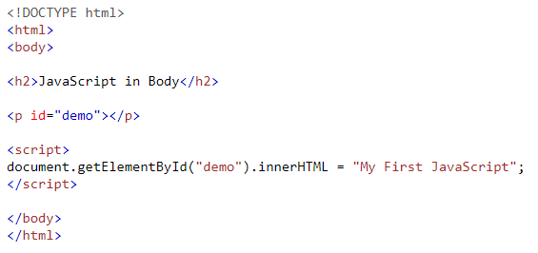
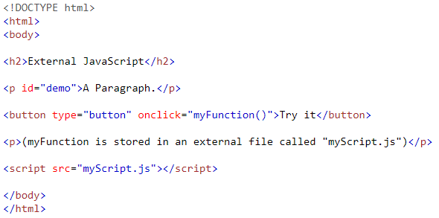
There are two ways how we can use JavaScript:
Directly in HTML:
In other file, then link it to HTML using script tag:

Slide 7
Java script Syntax
Before we start you should know the difference between var, let and const.
Variables declared by var keyword are scoped to the immediate function body, while let variables are scoped to the immediate enclosing block denoted by { }, and const must be assigned a value when they are declared (It does NOT define a constant value. It defines a constant reference to a value.).
Some people would argue that in the future we'll ONLY use let statements and that var statements will become obsolete, but today that is not the case.
If you are using some transpiler while writing JavaScript client code you are safe to use let, but if not, you need to check for browser support.
JavaScript has a long list of operators, here we will just show some of them, for whole list go to: JavaScript operators
Comments are written in one line are highlighted with // and comment blocks with /* comment */

Slide 8
The assignment operator (=) assigns a value to a variable. var x = 10;
Arithmetics operators.
Operator | Description
+ | Addition
- | Subtraction
* | Multiplication
** | Exponentiation (ES2016)
/ | Division
% | Modulus (Division Remainder)
++ | Increment
-- | Decrement

Slide 9
JavaScript Comparsion Operators
Operator | Description
== | equal to
=== | equal value and equal type
!= | not equal
!== | not equal value or not equal type
> | greater than
< | less than
>= | greater than or equal to
<= | less than or equal to
? | ternary operator

Slide 10
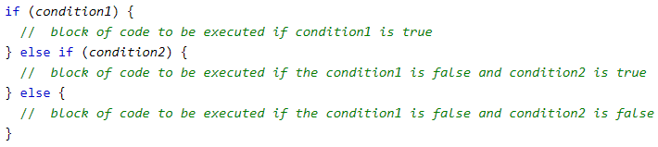
Conditionals and loops in Java script
JavaScript support conditionals and loops like most of other programming languages (if, while, do, for).
Use the if statement to specify a block of JavaScript code to be executed if a condition is true, use the else statement to specify a block of code to be executed if the condition is false and use the else if statement to specify a new condition if the first condition is false.
Use the switch statement to select one of many code blocks to be executed.

Slide 11
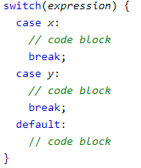


The while loop loops through a block of code as long as a specified condition is true.
The do/while loop is a variant of the while loop. This loop will execute the code block once, before checking if the condition is true, then it will repeat the loop as long as the condition is true.

Slide 12

The for loop has the following syntax:
Statement 1 is executed (one time) before the execution of the code block.
Statement 2 defines the condition for executing the code block.
Statement 3 is executed (every time) after the code block has been executed.
The break statement "jumps out" of a loop.
The continue statement "jumps over" one iteration in the loop.

Slide 13


Objects and functions
An object is collection of key-value pairs, without any particular ordering. Objects are created like this:
Object is a collection of related data and/or functionality (which usually consists of several variables and functions — which are called properties and methods when they are inside objects.)
A JavaScript funciton is defined with the function keyword, followed by a name, followed by parentheses ().
Function names can contain letters, digits, underscores, and dollar signs (same rules as variables).
The parentheses may include parameter names separated by commas: (parameter1, parameter2, ...)
The code to be executed, by the function, is placed inside curly brackets: {}
Function arguments are the values received by the function when it is invoked.

Slide 14
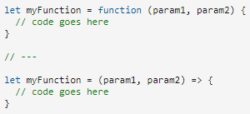
Arrow functions were introduced in ES6. They allow us to write shorter function syntax:
The handling of this is also different in arrow functions compared to regular functions. In short, with arrow functions there are no binding of this. In regular functions the this keyword represented the object that called the function, which could be the window, the document, a button or whatever. With arrow functions the this keyword always represents the object that defined the arrow function.
A Promise is a proxy for a value not necessarily known when the promise is created. It allows you to associate handlers with an asynchronous action's eventual success value or failure reason. This lets asynchronous methods return values like synchronous methods: instead of immediately returning the final value, the asynchronous method returns a promise to supply the value at some point in the future.
For more infomration check:
w3schools and MDN web docs

Slide 15
Questions

Slide 16
03. TYPESCRIPT basics
TypeScript intro
About TypeScript
Getting started with TypeScript
TypeScript and JavaScript
TypeScript Crash Course
Intro into Types
Core Types
Generics
Classes
Access Modifiers

Slide 17
TypeScript intro
TypeScript is a programming language developed and maintained by Microsoft. It is a strict syntactical superset of JavaScript and adds optional static typing to the language. TypeScript is designed for the development of large applications and transcompiles to JavaScript.
TypeScript may be used to develop JavaScript applications for both client-side and server-side execution (as with Node.js or Deno) and there are multiple options available for transcompilation.
TypeScript was first made public in October 2012 (at version 0.8), after two years of internal development at Microsoft.
TypeScript 4.2 was released on 25th, February 2021.
A study shows that 15% of all JavaScript bugs can be detected by TypeScript.
Other companies that use TypeScript are Slack, Stack, medium.com…
Reasons why we should use TypeScript are: it is more reliable, it is more explicit, JavaScript is practically interchangeable with it so why not…

Slide 18
Getting started with Typescript
TypeScript stands in an unusual relationship to JavaScript. TypeScript offers all of JavaScript’s features, and an additional layer on top of these: TypeScript’s type system.
For example, JavaScript provides language primitives like string and number, but it doesn’t check that you’ve consistently assigned these. TypeScript does.
This means that your existing working JavaScript code is also TypeScript code. The main benefit of TypeScript is that it can highlight unexpected behavior in your code, lowering the chance of bugs.

Slide 19
TYPESCRIPT crash course
TypeScript helps you avoid unwanted runtime errors by type-checking during development. TypeScript files are compiled into JavaScript files which can then be run in the browser or Node.
The compiler catches bugs in advance, saving time and frustration during debugging down the line.
TypeScript improves code clarity by explicitly defining the types of variables, function parameters, and function outputs. This allows you to tell at a glance exactly what your code should be taking and returning, and the compiler will throw an error if you accidentally pass something to a function that you shouldn't be.
The TypeScript compiler also allows you to customize what version of JavaScript your TS files compile to. This allows the developers to utilize many newer features of JavaScript without worrying about browser compatibility. Because of this, TypeScript can also offer features such as generics, enums, and interfaces which are not available in JavaScript.
Additionally, TypeScript offers fantastic tooling in modern code editors such as VS Code that can catch errors while the code as being written, saving even more time debugging

Slide 20
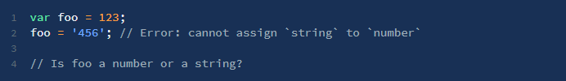
Intro into Types
Implicit Types TypeScript will try to infer as much of the type information as it can in order to give you type safety with minimal cost of productivity during code development. For example, in the following example TypeScript will know that foo is of type number below and will give an error on the second line as shown: This type inference is well motivated. If you do stuff like shown in this example, then, in the rest of your code, you cannot be certain that “foo” is a number or a string. Such issues turn up often in large multi-file code bases.
Explicit Types TypeScript uses postfix type annotations popular in other optionally annotated languages (e.g. ActionScript and F#). So if you do something wrong the compiler will report an error:

Slide 21
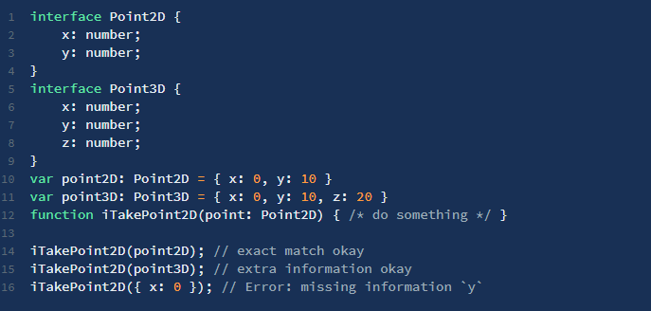
Types are structural In TypeScript because we really want it to be easy for JavaScript developers with a minimum cognitive overload, types are structural. This means that duck typing is a first class language construct. Consider the following example.

Slide 22
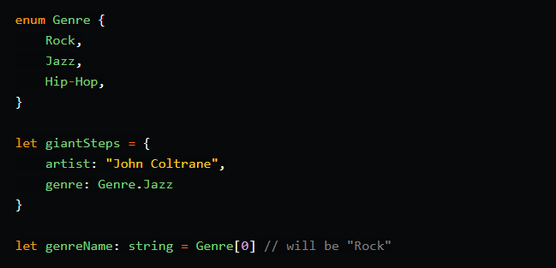
Enum An enum is a way of giving more friendly names to sets of numeric values.
Any The type of any can be used for variables whose values we do not yet know, or if we want to opt out of type-checking. This allows TypeScript to be very flexible, but use sparingly, as it eliminates the value added by TypeScript.
Null or Undefined Just as in JavaScript, null and undefined are types in TS. By default, null and undefined are subtypes of all other types, meaning you can assign null or undefined to a variable with the number type.

Slide 23
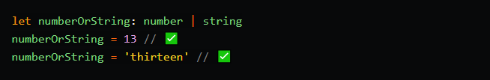
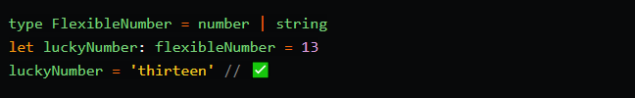
Never Never type represent the type of values that never occur. For example, a function that always throws an error when called will never return, so we can set the return type to never.
Object In Javascript, everything that isn't a primitive is an object. Thus, the object type represents any non-primitive, or anything that isn't a number, string, boolean, symbol, null, or undefined.
Union Types and Aliases If you variable or parameter needs to have more flexibility, you can specify multiple type options using union types. You can also define your own types, known as aliases, which can be used as type definitions later.

Slide 24
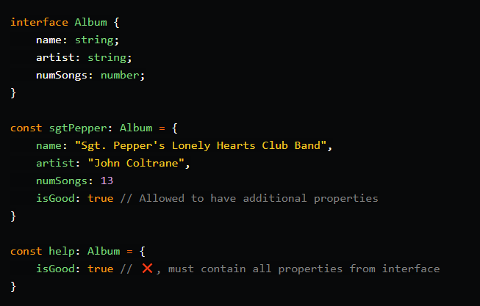
Interfaces Typescript allows us to define specific object shapes as a type, called an interface, which allows us to ensure the objects we are using always have the proper keys and value types.

Slide 25

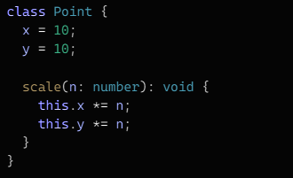
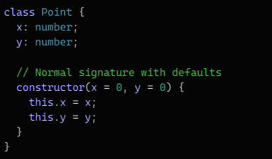
Generics
Generics allow us to create components that are compatible with a wide variety of types rather than a single one. This helps us make our component “open” and reusable.
For this we can also use the any type, so we can accept mote than single type for our component, but when we do that we are losing the information about what type was passed and returned of the function.
Classes
TypeScript offers full support for the class keyword introduced in ES2015.
As with other JavaScript language features, TypeScript adds type annotations and other syntax to allow you to express relationships between classes and other types.
Class contains next members: fields, constructors, getters / setters and methods.

Slide 26
TypeScript has some special inference rules for accessors:
If no set exists, the property is automatically readonly
The type of the setter parameter is inferred from the return type of the getter
If the setter parameter has a type annotation, it must match the return type of the getter
Getters and setters must have the same Member Visibility
It is not possible to have accessors with different types for getting and setting.
Access Modifiers
Access Modifiers control the accessibility of the member of our classes. Typescript support three access modifiers — public, private and protected.
Public Public members are available from anywhere without any restriction. This is also the standard modifier which means that you don’t need to prefix variables with the public keyword.
Private Private members can only be accessed in the class they are defined.
Protected Protected members can be accessed only within the class they are defined and every sub/child class.

Slide 27
Questions

Slide 28
04. Angular basics
Angular intro
About Angular
For what and why we use Angular
Getting started with Angular
VS code
Node
Angular CLI
Angular Crash Course
Components
Modules
Services
HTTP Client
Routing
Data Binding
Structural Directives
Attribute Directives
Folder Structure
Angular Extra
Angular Animations
Directives
Interceptors
Pipes
Guards

Slide 29
Angular intro
Angular (commonly referred to as "Angular 2+" or "Angular v2 and above") is a TypeScript-based open-source web application framework led by the Angular Team at Google and by a community of individuals and corporations. Angular is a complete rewrite from the same team that built AngularJS.
Originally, the rewrite of AngularJS was called "Angular 2", but this led to confusion among developers. To clarify, the Team announced that separate terms should be used for each framework with "AngularJS" referring to the 1.X versions and "Angular" without the "JS" referring to versions 2 and up.
Angular 2.0 was announced at the ng-Europe conference 22–23. October 2014. The drastic changes in the 2.0 version created considerable controversy among developers. The final version was released on September 14, 2016.

Slide 30
Getting started with Angular
When you are starting to write Angular application you just need some text editor. One of the best right now is Visual Studio Code. If you want to use some additional JS libraries you should have Node and NPM installed. For easier creation of new blank Angular applications you can also use Angular CLI.
Visual Studio Code is a source-code editor developed by Microsoft for Windows, Linux and macOS. It includes support for debugging, embedded Git control and GitHub, syntax highlighting, intelligent code completion, snippets, and code refactoring.
Node.js is an open-source, cross-platform, JavaScript runtime environment that executes JavaScript code outside of a browser. Node.js lets developers use JavaScript to write command line tools and for server-side scripting - running scripts server-side to produce dynamic web page content before the page is sent to the user's web browser.
npm (originally short for Node Package Manager) is a package manager for the JavaScript programming language. It is the default package manager for the JavaScript runtime environment Node.js.
Angular CLI is command-line interface tool that you use to initialize, develop, scaffold, and maintain Angular applications directly from a command shell.

Slide 31
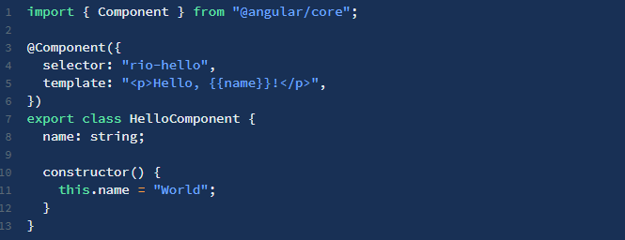
angular crash course
Angular allows you to create SPA's (Single Page Apps), SSR's (Server Side Rendered) and PWA's (Progressive Web Apps). For this tutorial, we're going focus just on the basics of building an SPA.
The fundamental building blocks of your Angular app are the components. Components consist of 3 elements:
The imports
The component decorator, which are various properties for your component. The component decorator includes locations to your component's template and CSS location.
The component logic, where your code resides.

Slide 32
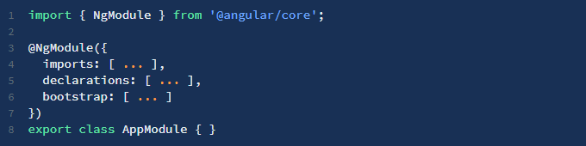
We attach @Component, a TypeScript decorator, which allows you to modify a class or function definition and adds metadata to properties and function arguments.
selector is the element property that we use to tell Angular to create and insert an instance of this component.
template is a form of HTML that tells Angular what needs to be to rendered in the DOM.
Services are special components that are reusable throughout your app. Usually we create them to separate some reusable logic from component, or for functions which communicate with our backend.
It looks similar to a component, except the import is an Injectable instead of a Component, and the decator is based on this @Injectable.
In Angular, a module is a mechanism to group components, directives, pipes and services that are related, in such a way that can be combined with other modules to create an application. An Angular application can be thought of as a puzzle where each piece (or each module) is needed to be able to see the full picture.
To be able to define modules we have to use the decorator NgModule.

Slide 33
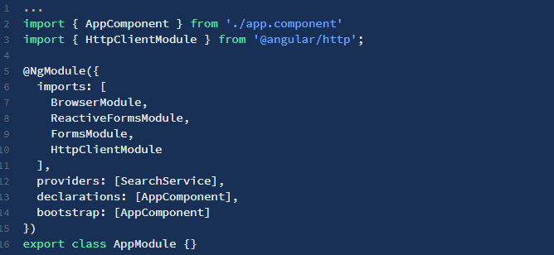
The property imports expects an array of modules. Here's where we define the pieces of our application. The property declarations expects an array of components, directives and pipes that are part of the module. The bootstrap property is where we define the root component of our module. Even though this property is also an array, 99% of the time we are going to define only one component.
Before moving on, there's an important clarification to make. There are two types of modules, root modules and feature modules. In the same way that in a module we have one root component and many possible secondary components, in an application we only have one root module and zero or many feature modules.
In order to start making HTTP calls from our Angular app we need to import the angular/http module and register for HTTP services. In order to use the various HTTP services we need to include HttpClientModule in the imports for the root NgModule.

Slide 34
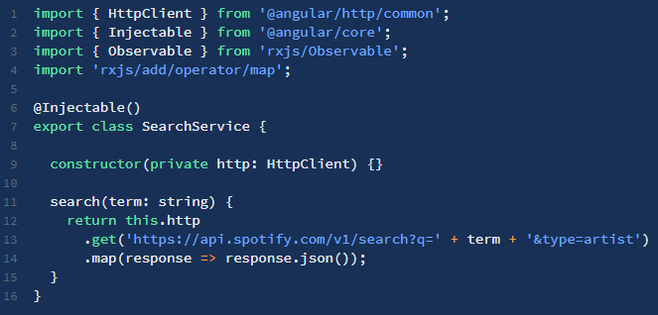
To make HTTP requests we will use the Http service.
Here we are making an HTTP GET request which is exposed to us as an observable. You will notice the .map operator chained to .get. The HttpClient service provides us with the raw response as a string. In order to consume the fetched data we have to convert it to JSON.
In addition to HttpClient.get(), there are also HttpClient.post(), HttpClient.put(), HttpClient.delete(), etc. They all return observables.

Slide 35

The Routes type is an array of routes that defines the routing for the application. This is where we can set up the expected paths, the components we want to use and what we want our application to understand them as.
Each route can have different attributes; some of the common attributes are:
path - URL to be shown in the browser when application is on the specific route
component - component to be rendered when the application is on the specific route
redirectTo - redirect route if needed; each route can have either component or redirect attribute defined in the route (covered later in this chapter)
pathMatch - optional property that defaults to 'prefix'; determines whether to match full URLs or just the beginning. When defining a route with empty path string set pathMatch to 'full', otherwise it will match all paths.
children - array of route definitions objects representing the child routes of this route (covered later in this chapter).

Slide 36
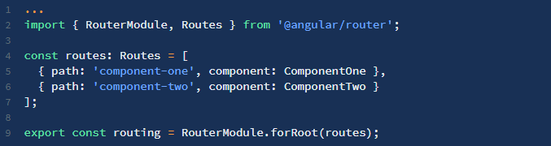
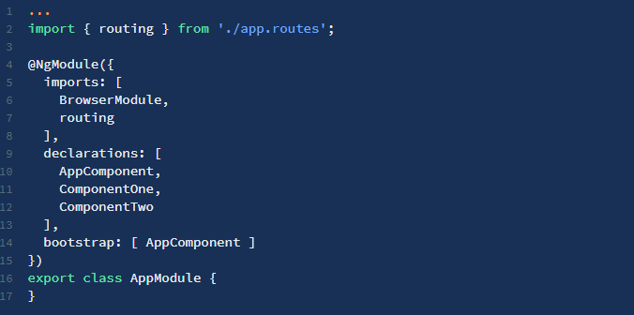
RouterModule.forRoot takes the Routes array as an argument and returns a configured router module.
We then import our routing configuration in the root of our application.

Slide 37
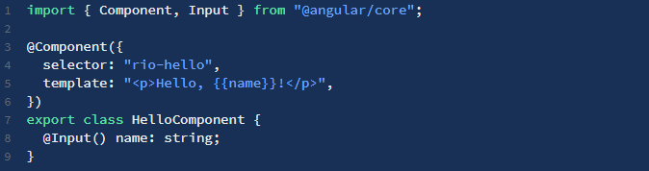

There are two ways to pass data into a component, with 'property binding' and 'event binding'. In Angular, data and event change detection happens top-down from parent to children. However for Angular events we can use the DOM event mental model where events flow bottom-up from child to parent. So, Angular events can be treated like regular HTML DOM based events when it comes to cancellable event propagation.
The @Input() decorator defines a set of parameters that can be passed down from the component's parent. For example, we can modify the HelloComponent component so that name can be provided by the parent.
The point of making components is not only encapsulation, but also reusability. Inputs allow us to configure a particular instance of a component.

Slide 38
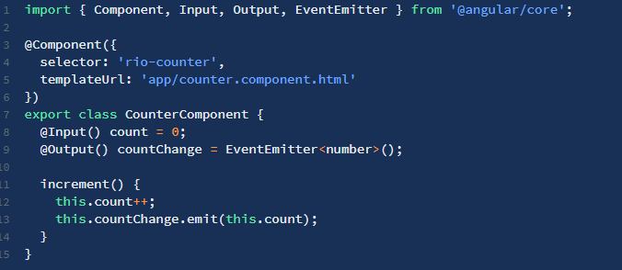
Two-way data binding combines the input and output binding into a single notation using the ngModel directive.
To create your own component that supports two-way binding, you must define an @Output property to match an @Input, but suffix it with the Change. The code example below shows how to make property count support two-way binding.

Slide 39
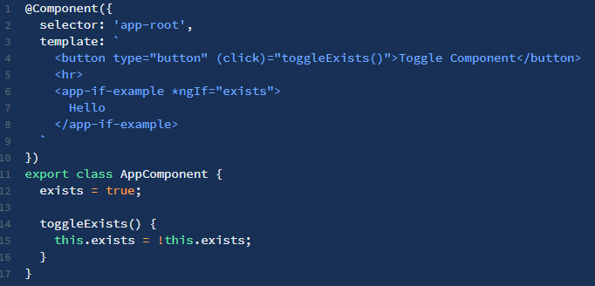
Structural Directives are a way of handling how a component or element renders through the use of the template tag. This allows us to run some code that decides what the final rendered output will be. Angular has a few built-in structural directives such as ngIf, ngFor, and ngSwitch.
The ngIf directive conditionally adds or removes content from the DOM based on whether or not an expression is true or false.
Clicking the button will toggle whether or not IfExampleComponent is a part of the DOM and not just whether it is visible or not. This means that every time the button is clicked, IfExampleComponent will be created or destroyed. This can be an issue with components that have expensive create/destroy actions. For example, a component could have a large child subtree or make several HTTP calls when constructed. In these cases it may be better to avoid using ngIf if possible.

Slide 40
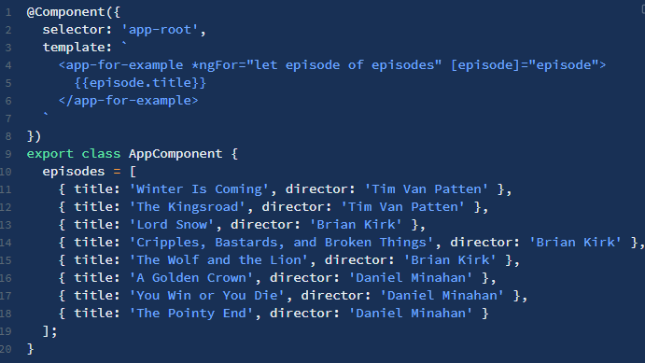
The NgFor directive is a way of repeating a template by using each item of an iterable as that template's context. NgFor lets you specify an iterable object to iterate over and the name to refer to each item by inside the scope.

Slide 41
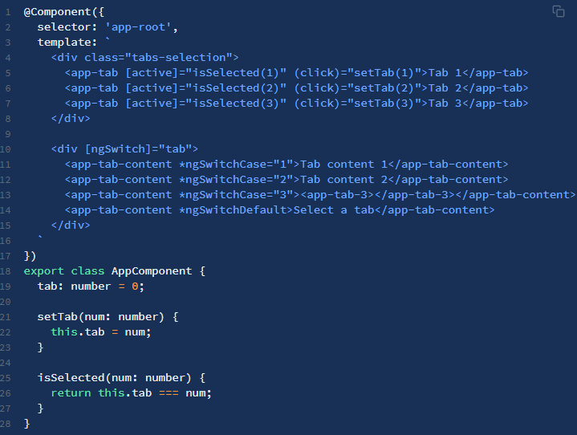
ngSwitch is actually comprised of two directives, an attribute directive and a structural directive. It's very similar to a switch statement in JavaScript and other programming languages, but in the template.
If an expression bound to ngSwitchCase matches the one given to ngSwitch, those components are created and the others destroyed. If none of the cases match, then components that have ngSwitchDefault bound to them will be created and the others destroyed. Note that multiple components can be matched using ngSwitchCase and in those cases all matching components will be created.

Slide 42
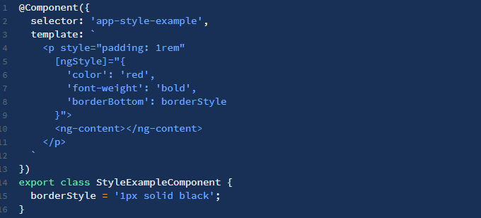
Attribute directives are a way of changing the appearance or behavior of a component or a native DOM element. Ideally, a directive should work in a way that is component agnostic and not bound to implementation details.
Angular provides a built-in directive, ngStyle, to modify a component or element's style attribute.
Here, we're binding an expression, an object literal, to the ngStyle directive so the directive name must be enclosed in square brackets. ngStyle accepts an object whose properties and values define that element's style. In this case, we can see that both kebab case and lower camel case can be used when specifying a style property. Also notice that both the html style attribute and Angular ngStyle directive are combined when styling the element.

Slide 43
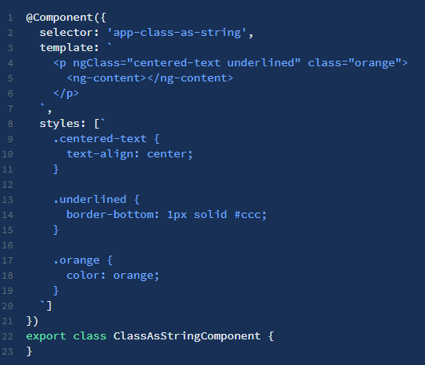
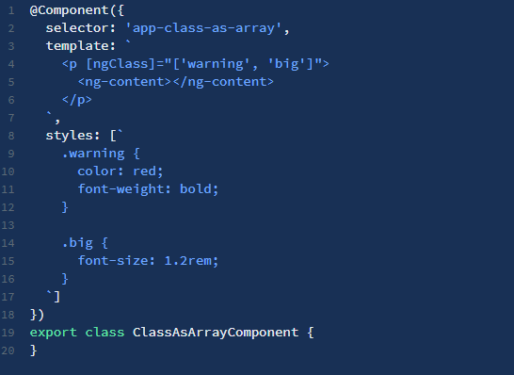
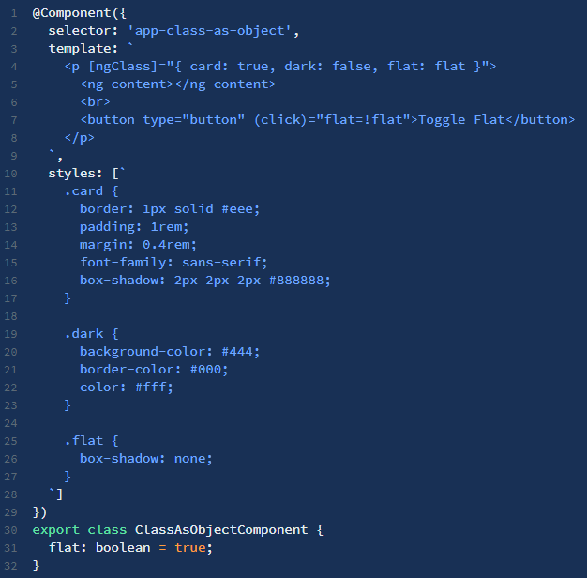
The ngClass directive changes the class attribute that is bound to the component or element it's attached to. There are a few different ways of using the directive.
Binding a string
Binding an array
Binding an object

Slide 44
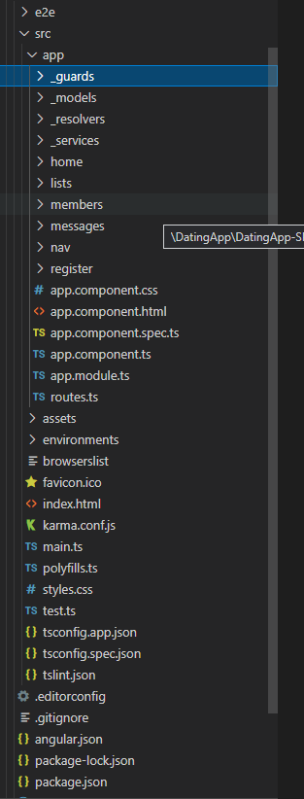
Folder structure is very important, specially when you are working on big enterprise projects. Best practice is to follow this rule: Do structure the app such that you can Locate code quickly, Identify the code at a glance, keep the Flattest structure you can, and Try to be DRY.
So you should separate all services to single folder, also do that with your guards, models and resolvers. Components should be grouped by features, if multiple components are responsible for one feature they should be grouped in same folder.

Slide 45
angular Extra
Angular's animation system is built on CSS functionality, which means you can animate any property that the browser considers animatable. This includes positions, sizes, transforms, colors, borders, and more. The W3C maintains a list of animatable properties on its CSS Transitions page. More about Angular animations you can find on this link.
A Directive modifies the DOM to change apperance, behavior or layout of DOM elements. Directives are one of the core building blocks Angular uses to build applications. In fact, Angular components are in large part directives with templates. You can create custom directives, more on that you can read here. One of use cases for directives is when you want to create some reusable parts like a tooltip, and similar.
There are two type of Interceptors. HttpInterceptor intercepts and handles an HttpRequest or HttpResponse, we use it for adding JWT to our HTTP requests, or for error handling when some HTTP request fails. JsonpInterceptor identifies requests with the method JSONP and shifts them to the JsonpClientBackend.
Angular provides a way of filtering data: Pipes. A pipe takes in data as input and transforms it to a desired output.

Slide 46
Angular provides few built-in pipes which can be used out of the box. You can also create custom pipes when needed.
Angular’s route guards are interfaces which can tell the router whether or not it should allow navigation to a requested route. They make this decision by looking for a true or false return value from a class which implements the given guard interface.

Slide 47
Questions

Slide 48
05. Surveyjs library
About SurveyJS
About SurveyJS
SurveyJS and Angular
Useful links

Slide 49
About surveyjs
The SurveyJS Library is a JavaScript library that available for five platforms:
Angular
jQuery
knockout
react
vue
The library itself consists of two parts:
Survey Model - A platform independent part. In the most case, you work with Survey Model.
The platform specific code - This part deals with rendering and processing mouse and keyboard events.

Slide 50
Survey Objects
SurveyJS implements three main object types:
survey,
containers (pages and panels),
questions.
The survey object is the root element, that contains top level properties/options, methods, and events. It contains top-level containers – pages. Every page may contain unlimited number of panels and questions, where panel can contain another panels and questions (nested panels are supported).
SurveyJS and Angular
To use SurveyJS library with a Angular framework we are going to use npm package called survey-angular.
To install it we are going to use node package manager and type next command: npm i survey-angular.
Then follow this guide: https://surveyjs.io/Documentation/Library/?id=Add-Survey-into-your-Web-Page.
Useful Links
https://www.npmjs.com/package/survey-angular
https://surveyjs.io/Documentation/Library?id=LibraryOverview

Slide 51
Questions

Slide 52
Resources
TypeScript: https://dev.to/shane__lonergan/typescript-in-a-weekend-a-crash-course-2171#null-and-undefined https://www.typescriptlang.org/docs/handbook/intro.html
https://basarat.gitbook.io/typescript/
https://gabrieltanner.org/blog/typescript-crash-course
Angular:
https://angular.io/docs
https://coursetro.com/posts/code/174/Angular-8-Tutorial-&-Crash-Course
https://angular-2-training-book.rangle.io/

Slide 53
Thank you
Serbia / NOVI SAD
Levi9 Global Sourcing Balkan d.o.o.
Novi Sad Offices
Trifkovićev trg 6
21000 Novi Sad, Serbia

